Slide 1

Windows Sysinternals Know Your Tools

Slide 2

PS C:\> $env:USERNAME Alex Bytes
Senior engineer for [super secret] organisation
Looks after ‘all the things’
Blogger of IT
bytesizedalex.com - Byte sized for when a nibble just isn't enough!
Twitter - @bytesizedalex
The switches/options available on many tools are too extensive to go into detail however I will try and cover the basics
Some slides are for reference so we will skip past them quickly
Download links and references can be found on my website in todays post – bytesizedalex.com/techug-march-2018

Slide 3
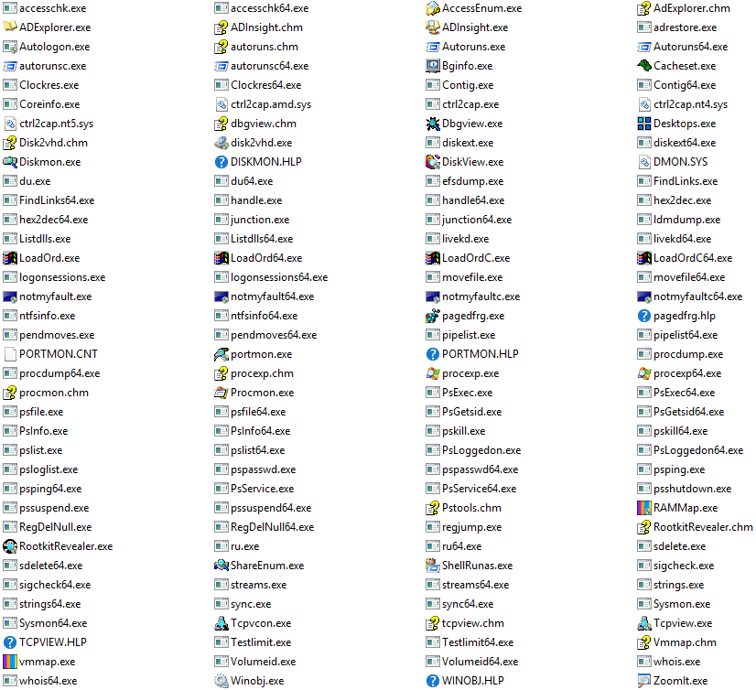
Audience Question
Do you currently use any of the Sysinternals suite?

Slide 4
What is the Sysinternals suite?
Created in 1996 by Mark Russinovich – tools added and updated regularly over the past two decades
Comprised of command line and GUI tools for troubleshooting and diagnostics (mostly)
Like a Swiss army knife some tools are useful everyday while others are highly specific

Slide 5


Wow, Such Tool
Actually a real one – Wenger Giant

Slide 6


Slide 7
Agenda
Discuss a small selection of the Sysinternals suite
BGInfo
VMmap
Du
Procmon
Procexp
Sysmon
Hopefully time for a demo of Procmon, Procexp and Sysmon
Time for questions at the end but please feel free to wave your arms around enthusiastically if you have any during the talk
Where arm waving fails please try cartwheels around the room

Slide 8
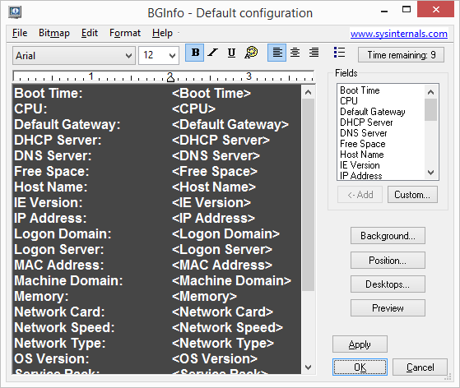
BGInfo – Background Info
Probably one of the best known Sysinternals tools
Modifies desktop background with useful information
Pre-defined fields provide a broad range of information
Works on –
Client: Windows Vista and higher
Server: Windows Server 2008 and higher

Slide 9
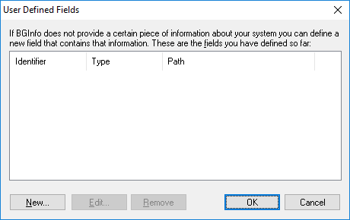
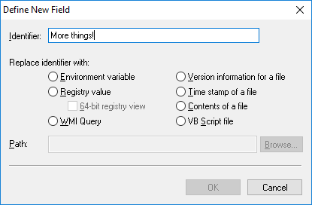
BGInfo - Custom Fields
Why stop at the defaults when you can have more!

Slide 10
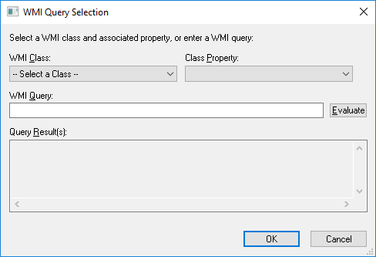
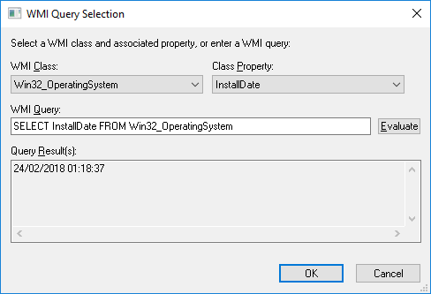
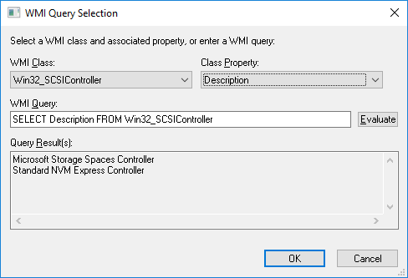
Custom Fields - WMI
Anything from Win32_* class

Slide 11
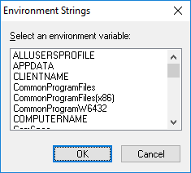
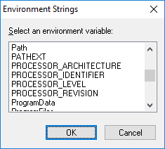
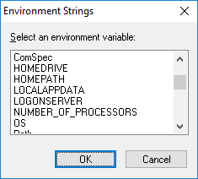
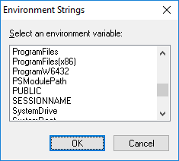
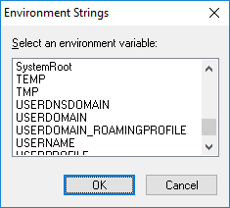
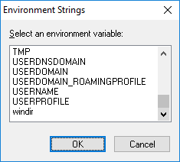
Custom Fields – Environment Variables
Select from system defined environment variables
These can be expanded by installed software or configurations
Use ‘set’ command to see them from traditional cmd.exe window

Slide 12
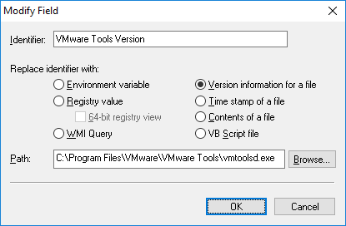
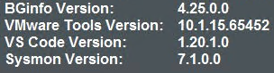
Custom Fields – File Version
Handy way of displaying application version information on the desktop – hypervisor guest tools version, AV or perhaps version information for the installed application – SQL etc

Slide 13
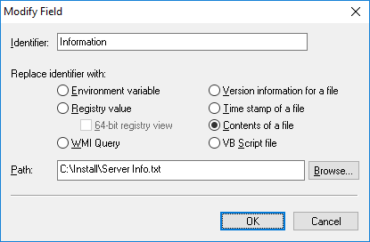
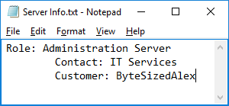
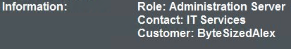
Custom Fields – File Content
Pull data from a file and write to desktop
You could write a script to export data to a file then read that info BGInfo
Really gives you a lot of options for data display

Slide 14
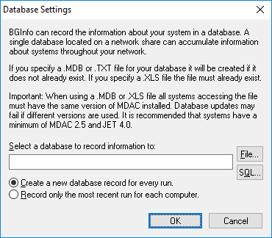
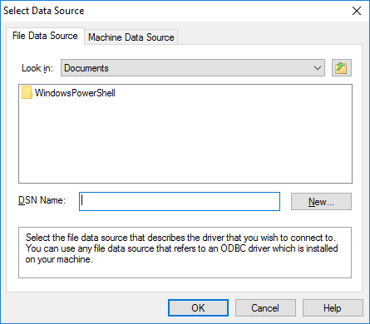
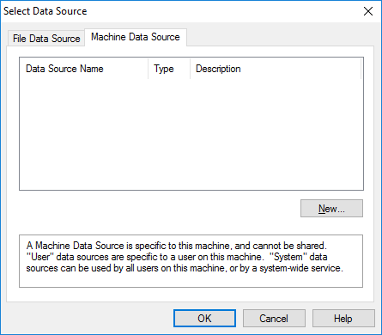
BGInfo – Asset Management
File|Database: Specifies a .XLS, .MDB or .TXT file or a connection string to an SQL database that BGInfo should use to store the information it generates. You must ensure that all systems that access the file have the same version of MDAC and JET database support installed. It is recommended you use at least MDAC 2.5 and JET 4.0. If specifying an XLS file the file must already exist.

Slide 15
BGInfo Command Line Syntax
Parameter | Description
<path> | Specifies the name of a configuration file to use for the current session. Changes to the configuration are automatically saved back to the file when OK or Apply is pressed. If this parameter is not present BGInfo uses the default configuration information which is stored in the registry under the current user ("HKEY_CURRENT_USER\Software\Winternals\BGInfo").
/timer | Specifies the timeout value for the countdown timer, in seconds. Specifying zero will update the display without displaying the configuration dialog. Specifying 300 seconds or longer disables the timer altogether.
/popup | Causes BGInfo to create a popup window containing the configured information without updating the desktop. The information is formatted exactly as it would if displayed on the desktop, but resides in a fitted window instead. When using this option the history database is not updated.
/silent | Suppresses error messages.
/taskbar | Causes BGInfo to place an icon in the taskbar's status area without updating the desktop. Clicking the icon causes the configured information to appear in a popup window. When using this option the history database is not updated.
/all | Specifies that BGInfo should change the wallpaper for any and all users currently logged in to the system. This option is useful within a Terminal Services environment, or when BGInfo is scheduled to run periodically on a system used by more than one person (see Using a Schedule below).
/log | Causes BGInfo to write errors to the specified log file instead of generating a warning dialog box.
/rtf | Causes BGInfo to write its output text to an RTF file. All formatting information and colors are included.

Slide 16
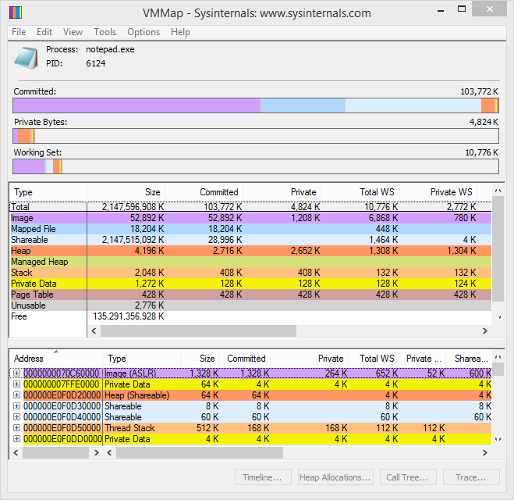
VMMap
Virtual and physical memory analysis utility. It shows a breakdown of a process's committed virtual memory types as well as the amount of physical memory (working set) assigned by the operating system to those types
Supports export of data in multiple formats
Works on –
Client: Windows Vista and higher
Server: Windows Server 2008 and higher

Slide 17


VMMap - Scenario
Customer complains an important report fails to run – it worked previously but now fails
They contacted the application vendor who advised the error code indicates ‘out of memory’
Vendor states virtual machine lacks sufficient memory hence the software crashes when attempting to run large reports
“They say we haven’t given the server enough memory!”

Slide 18
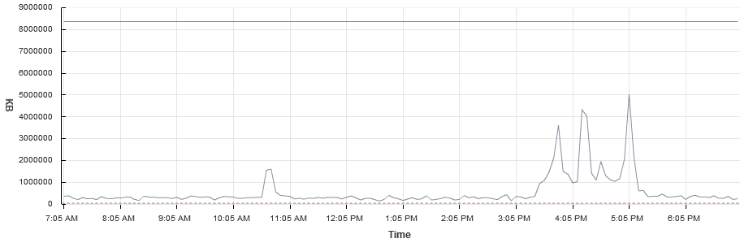
Report Server Setup
Windows Server 2008 R2 virtual server
8GB RAM allocated
Customer asked to run report while we monitor
Memory usage increases somewhat but still plenty server memory available

Slide 19
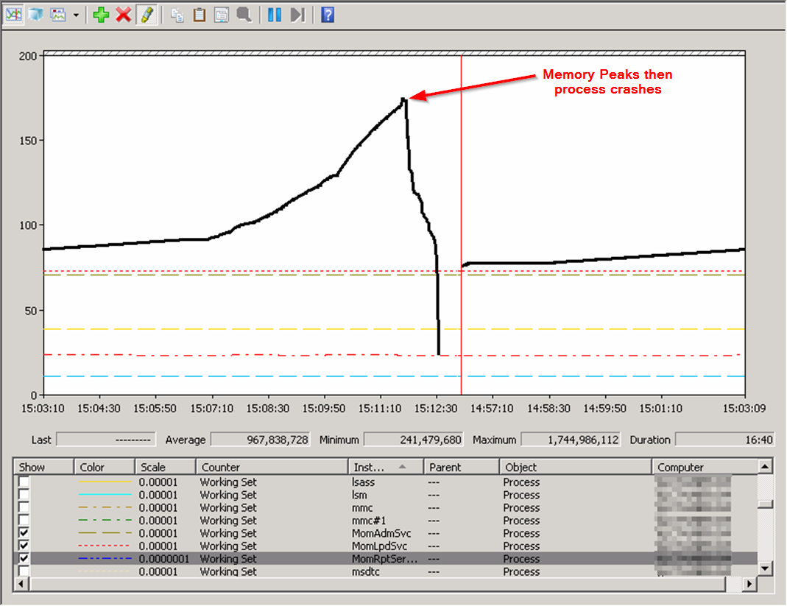
Monitor utilisation to determine problem process

Slide 20
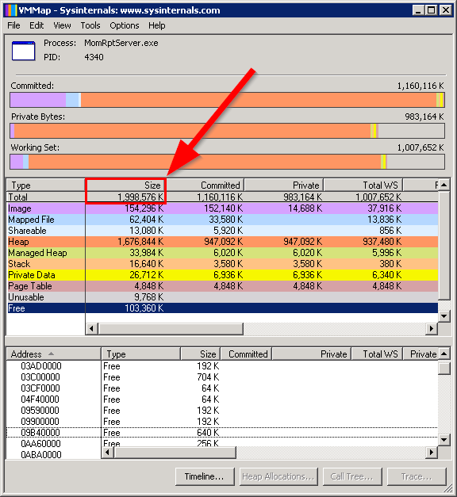

App Memory Limit
2GB

Slide 21

2GB Application Memory Limit
Application is exhausting it’s 2GB address space
Adding more memory to the server is not going to help!
By saving the VMMap results we can send to the supplier and let them review exactly what was going on with their memory usage

Slide 22
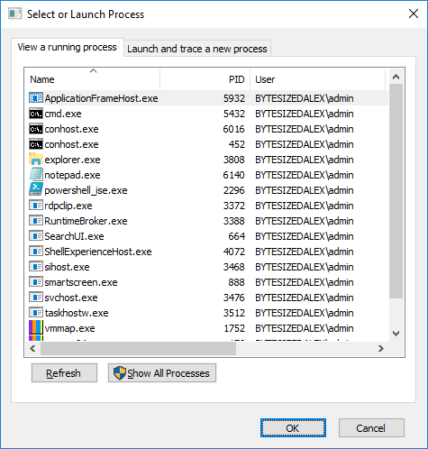
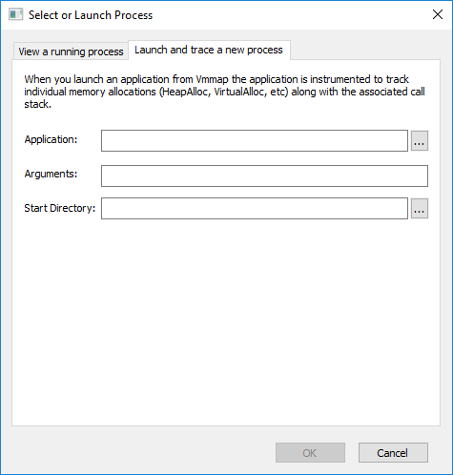
VMmap GUI Options

Slide 23
VMMap Command Line Syntax
vmmap [-64] [-p <pid or process name> [outputfile]] | [-o <inputfile>]
The output file will be created as a native VMMap .mmp file unless you specify .xml or .csv as the file extension, which will save as XML or CSV respectively.
Parameter | Description
-64 | Run the 64-bit version to analyze a 32-bit process
-p | Specifies process VMMap will scan on startup
Outputfile | Has VMMap dump scan output to file and exit
Inputfile | Has VMMap load the specified file on startup

Slide 24
Du – Disk Usage
Provides space utilisation report for given directory
By default recursively scans directory and child directories for total utilisation
Output can be redirected to CSV or Tab-Delimited files for review, in Excel for example
See which users/departments are consuming all your expensive storage!
Example – my ‘Steam’ directory usage
du -c -l 1 d:\steam\steamapps\common > d:\steamusage.csv

Slide 25
Du Example Report Output
Path | CurrentFileCount | CurrentFileSize | FileCount | DirectoryCount | DirectorySize | Size | SizeGB
Deus Ex Mankind Divided | 0 | 0 | 2420 | 12 | 60906250 | 59478.8 | 58.08
Warhammer End Times Vermintide | 0 | 0 | 8292 | 23 | 52014186 | 50795.1 | 49.60
PAYDAY 2 | 37 | 29750 | 7923 | 38 | 49442047 | 48283.2 | 47.15
Wolfenstein.The.New.Order | 5 | 27118 | 342 | 46 | 45681652 | 44611 | 43.57
ShadowOfMordor | 44 | 32816141 | 496 | 40 | 44863372 | 43811.9 | 42.79
Dishonored2 | 6 | 117541 | 355 | 11 | 43661212 | 42637.9 | 41.64
BioShock Infinite | 3 | 27 | 10200 | 131 | 43359511 | 42343.3 | 41.35
Wolfenstein The Old Blood | 5 | 29193 | 235 | 21 | 38163855 | 37269.4 | 36.40
Dawn of War III | 22 | 398545 | 22007 | 38 | 31517498 | 30778.8 | 30.06
Arma 3 | 26 | 172424 | 1190 | 73 | 31019254 | 30292.2 | 29.58
Sniper Elite 3 | 3 | 220 | 794 | 72 | 26580767 | 25957.8 | 25.35
Dishonored_DeathOfTheOutsider | 6 | 165033 | 270 | 12 | 24545744 | 23970.5 | 23.41
Team Fortress 2 | 3 | 182 | 2438 | 329 | 21681527 | 21173.4 | 20.68
left 4 dead 2 | 42 | 780992 | 53238 | 698 | 19628091 | 19168.1 | 18.72
Deus Ex Human Revolution Director's Cut | 18 | 18547696 | 179 | 6 | 18657677 | 18220.4 | 17.79
PlanetSide 2 | 98 | 130046 | 1223 | 71 | 17831280 | 17413.4 | 17.01
Subnautica | 6 | 22566 | 16743 | 39 | 14765602 | 14419.5 | 14.08
Dishonored | 1 | 1 | 5857 | 42 | 13686345 | 13365.6 | 13.05
Black Mesa | 3 | 234 | 1362 | 73 | 13592815 | 13274.2 | 12.96
Battlefleet Gothic Armada | 3 | 601 | 74 | 48 | 13443559 | 13128.5 | 12.82
Etc…

Slide 26
Du Example Report Output

Slide 27
Du Command Line Syntax
Usage: du [-c[t]] [-l <levels> | -n | -v] [-u] [-q] <directory>
CSV output is formatted as:
Path,CurrentFileCount,CurrentFileSize,FileCount,DirectoryCount,DirectorySize,DirectorySizeOnDisk
Parameter | Description
-c | Print output as CSV. Use -ct for tab delimiting.
-l | Specify subdirectory depth of information (default is all levels)
-n | Do not recurse.
-v | Show size (in KB) of intermediate directories.
-u | Count each instance of a hardlinked file.
-q | Quiet (no banner).

Slide 28
ProcMon – Process Monitor
Awesome level is over 9000! (if you don’t know your DBZ references just assume this is funny)
Referencing the official post –
Advanced monitoring tool
Shows real-time file system, Registry and process/thread activity
Rich and non-destructive filtering
Comprehensive event properties such session IDs and user names
Reliable process information
Full thread stacks with integrated symbol support for each operation
Simultaneous logging to a file
Plus more stuff!

Slide 29
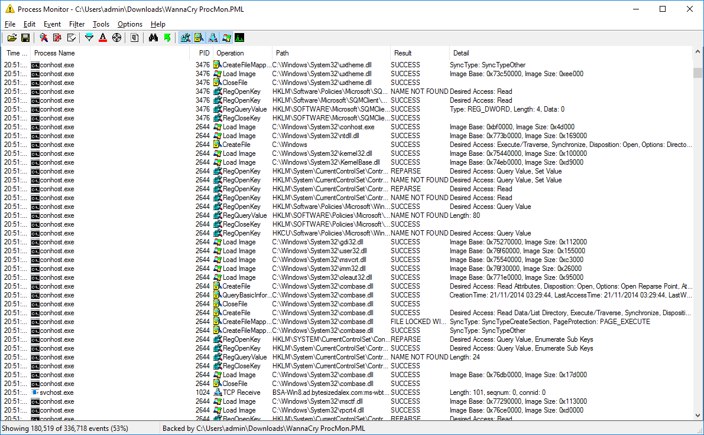
ProcMon – Most Awesome Interface Ever!

Slide 30
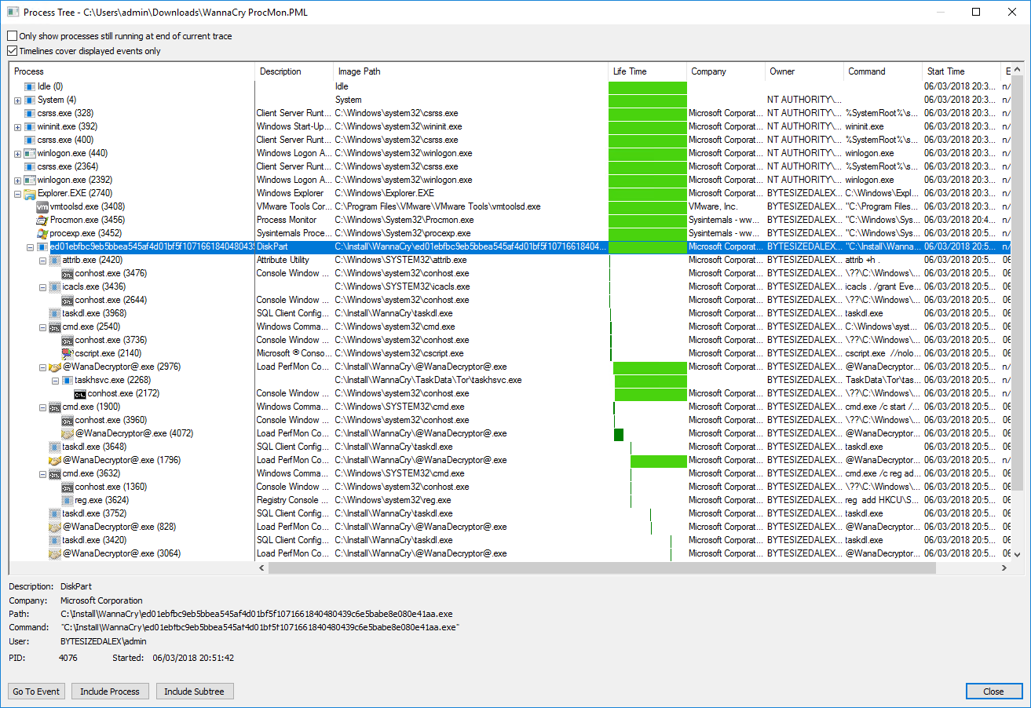
ProcMon Process Tree

Slide 31
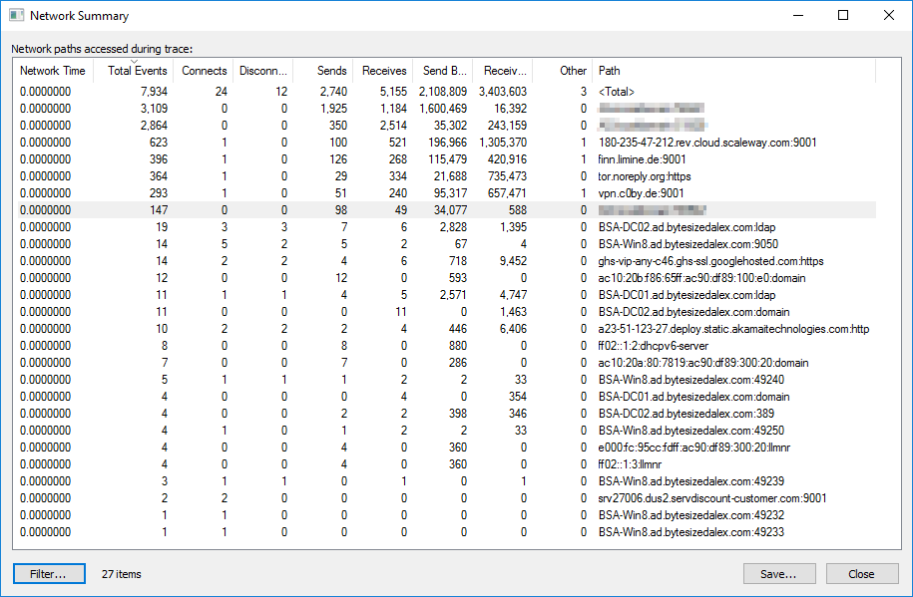
ProcMon – Network Summary

Slide 32
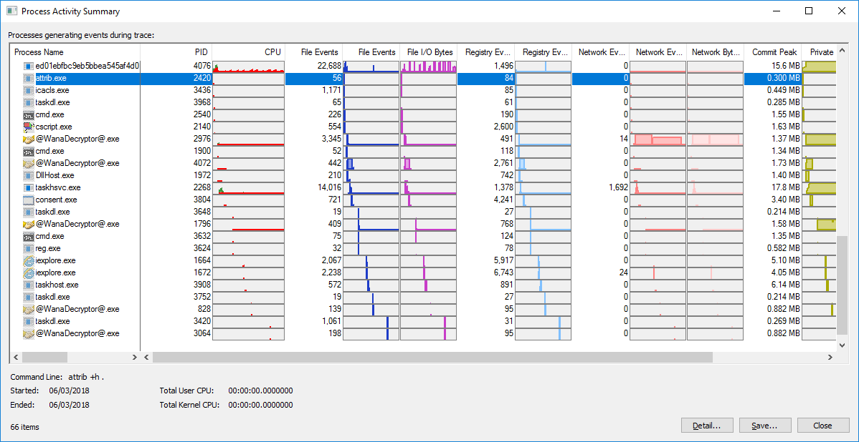
ProcMon - Process Activity Summary

Slide 33
ProcMon Capabilities (read later)
As defined by the ProcMon Sysinternals page…
Process Monitor includes powerful monitoring and filtering capabilities, including:
More data captured for operation input and output parameters
Non-destructive filters allow you to set filters without losing data
Capture of thread stacks for each operation make it possible in many cases to identify the root cause of an operation
Reliable capture of process details, including image path, command line, user and session ID
Configurable and moveable columns for any event property
Filters can be set for any data field, including fields not configured as columns
Advanced logging architecture scales to tens of millions of captured events and gigabytes of log data
Process tree tool shows relationship of all processes referenced in a trace
Native log format preserves all data for loading in a different Process Monitor instance
Process tooltip for easy viewing of process image information
Detail tooltip allows convenient access to formatted data that doesn't fit in the column
Cancellable search
Boot time logging of all operations

Slide 34
Procmon Command Line Syntax
Parameter | Description
/OpenLog <PML File> | Open a previously saved event file
/BackingFile <PML File> | Save events in the specified backing file
/PagingFile | Save events in the virtual memory
/NoConnect | Don’t automatically begin collecting events at start up
/NoFilter | Clear the filter at start up
/AcceptEula | Accept the EULA automatically (don’t show a dialog)
/LoadConfig <File> | Load a previously saved configuration file
/Profiling | Enable the thread profiling feature
/Minimized | Start the application minimized
/WaitForIdle | Wait for an instance of ProcMon to become ready
/Terminate | Terminate all instances of ProcMon and exit
/Quiet | Don’t confirm filter settings during start up
/Run32 | Run the 32-bit version to load 32-bit log files (x64 only)
/Runtime | Run for the specified number of seconds and terminate
/HookRegistry | Hook Registry for Softgrid troubleshooting (x86 Vista only)
/SaveAs <Path> | Export to an XML, CSV or PML file
/SaveAs1 <Path> | Export including stack traces (XML only)
/SaveAs2 <Path> | Export including stack traces with symbols (XML only)
/SaveApplyFilter | Apply current filter before exporting
/EnableBootLogging | Configures logging of next boot
/ConvertBootLog <PML File> | Automatically processes a boot log after reboot
Really useful

Slide 35
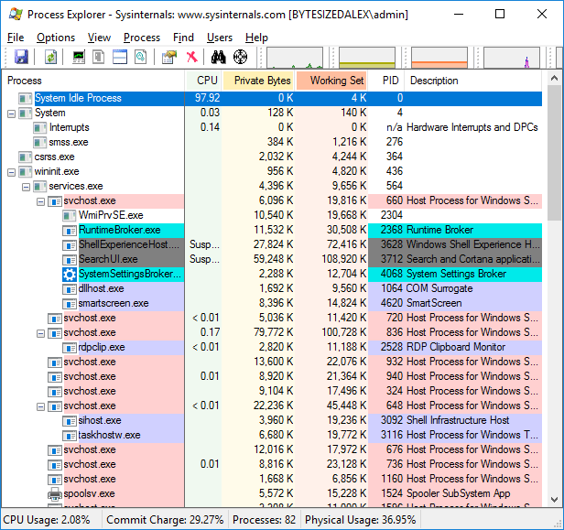
ProcExp - Process Explorer
Task Manager on steroids
Microsoft ‘borrow’ features each OS release to add to Task Manager
Extensive options and functionality – vastly superior to Task Manager but can be overkill if you just want basic info
Works on –
Client: Windows Vista and higher (Including IA64)
Server: Windows Server 2008 and higher (Including IA64)

Slide 36

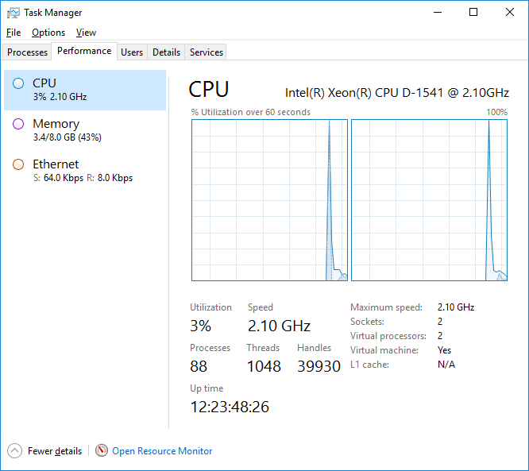
OK so it’s basically a fancy Task Manager – tell me something cool I can do with it!
Fancy
Task Manager

Slide 37
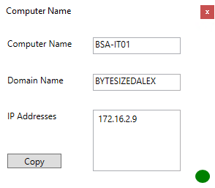
Using Signatures To Verify Processes
Digital signatures help to confirm who wrote/published a program – not all code is signed, this can lead to false attribution (i.e it claims to come from somebody it didn’t)
Microsoft were kind enough to write me an application that displays some useful information (or maybe I wrote it)
Let’s see what it looks like in Task Manager

Slide 38
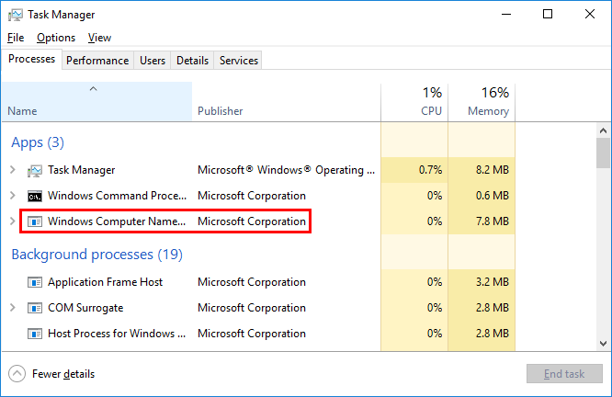
Has to be legit right?

Slide 39
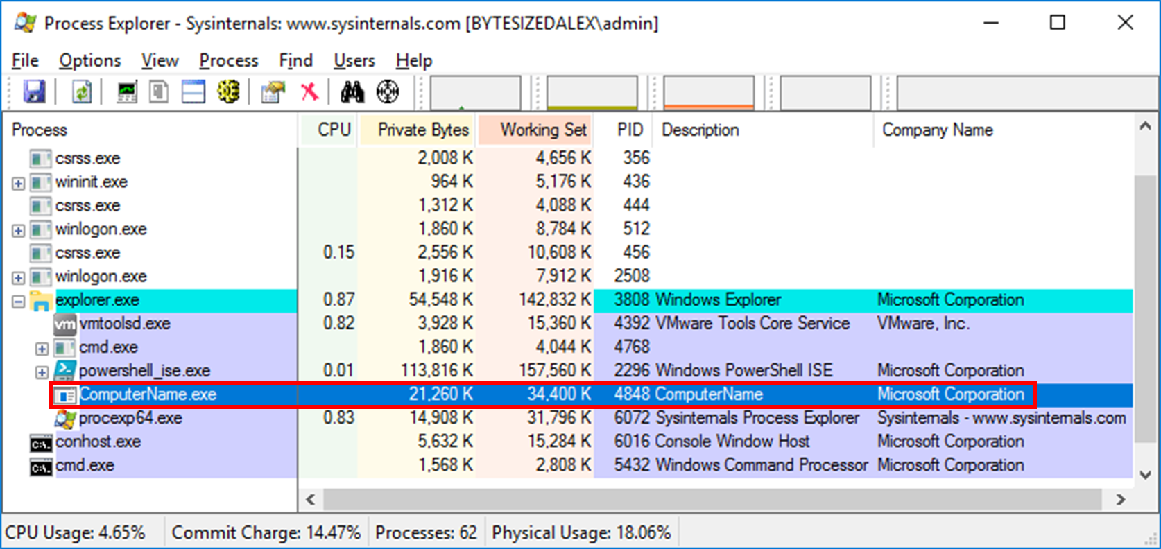
ProcExp Agrees (Obviously, same field!)

Slide 40
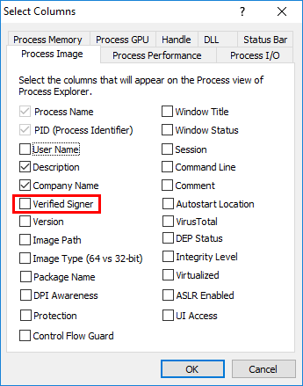
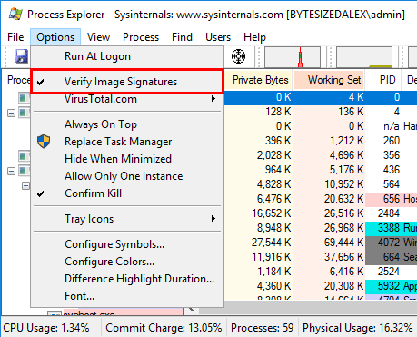
Verified Signers
How about we check the digital signature?
No way to do this in Task Manager

Slide 41
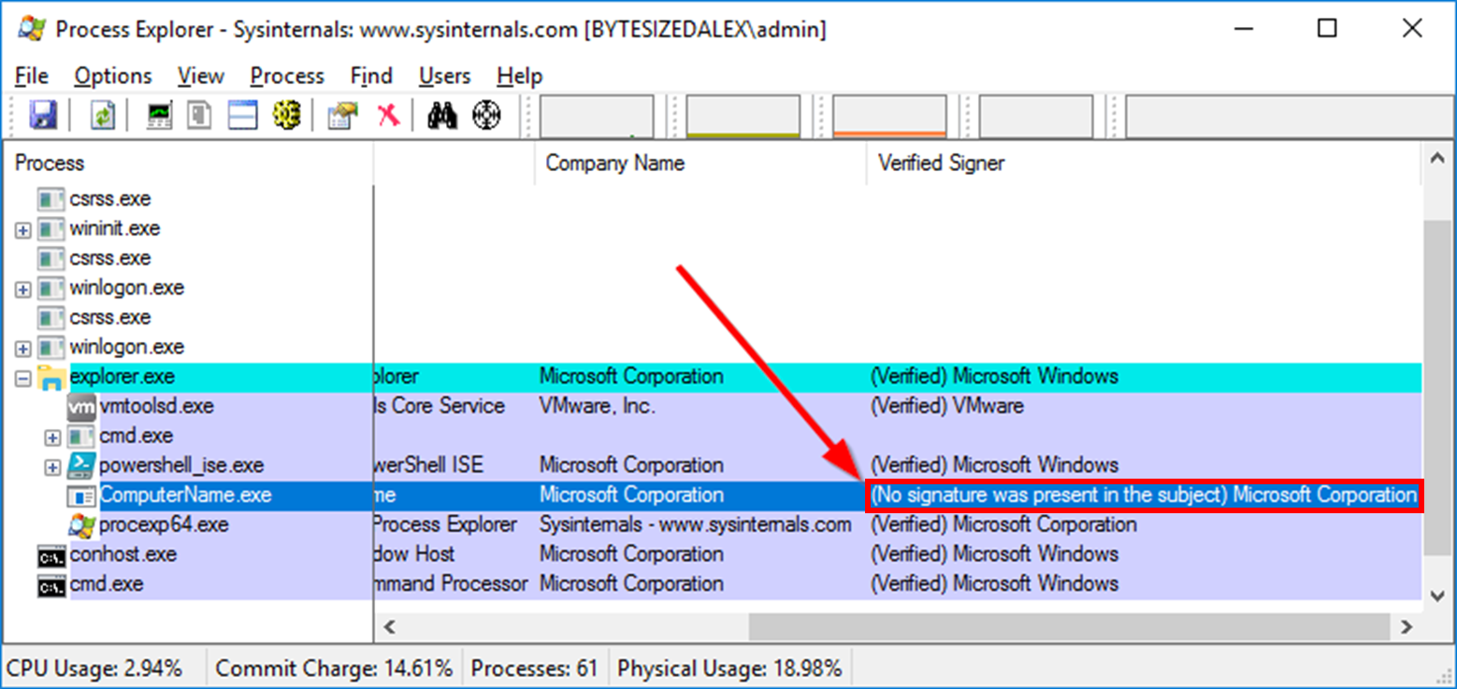
ProcExp Checks Signature
The code is not signed – one expects Microsoft software to be digitally signed, lack of signature should make you suspicious

Slide 42
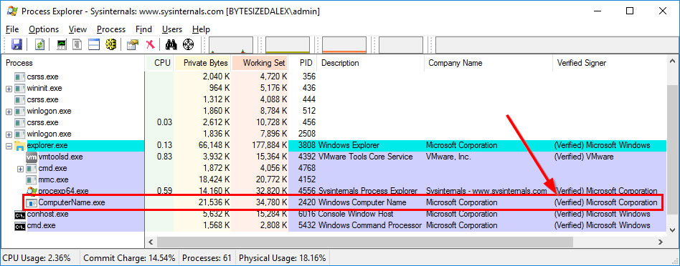
Of course I want my program to look like it is signed by Microsoft… ¯\_(ツ)_/¯

Slide 43

What is this madness?!?

Slide 44
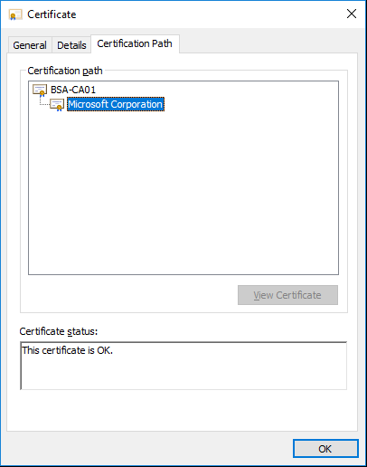
Understand Certificate Chains
A file signed by a certificate which chains to a trusted root will show as verified
Be sensible about who you trust
Keep code signing private keys safe
Digitally signed malware was historically rare however these days it is a reality
http://legacydirs.umiacs.umd.edu/~tdumitra/papers/CCS-2017.pdf (Certified Malware: Measuring Breaches of Trust in the Windows Code-Signing PKI)
https://arxiv.org/abs/1803.02931 (Issued for Abuse: Measuring the Underground Trade in Code Signing Certificate)
https://www.theregister.co.uk/2018/03/12/susicious_digital_cetificate_sales

Slide 45
ProcExp Command Line Syntax
Parameter | Description
/e | Prompt for UAC elevation to restart with administrative rights if launched without administrative rights
/s:<pid> | Select the process having the specified process ID after starting
/t | Start Process Explorer minimized in the tray
/p:[r|h|n|l] | Set Process Explorer's priority to realtime (r), high (h), normal (n), or low (l)

Slide 46
Sysmon - System Monitor
Windows system service and device driver that monitors and logs system activity to the Windows event log
By collecting the events it generates using Windows Event Collection or SIEM agents we can identify malicious or anomalous activity
Sysmon is not an analysis tool – it simply gathers the data. It does not have any protection so malware can look to kill it
“He who is prudent and lies in wait for an enemy who is not, will be victorious.”
Works on –
Client: Windows 7 and higher
Server: Windows Server 2008 R2 and higher

Slide 47
Sysmon – Features (turns out it has a few)
Read these later when you review my slides ;-)
Logs process creation with full command line for both current and parent processes
Records the hash of process image files using SHA1 (the default), MD5, SHA256 or IMPHASH
Multiple hashes can be used at the same time
Includes a process GUID in process create events to allow for correlation of events even when Windows reuses process IDs
Include a session GUID in each events to allow correlation of events on same logon session
Logs loading of drivers or DLLs with their signatures and hashes
Logs opens for raw read access of disks and volumes
Optionally logs network connections, including each connection’s source process, IP addresses, port numbers, hostnames and port names
Detects changes in file creation time to understand when a file was really created. Modification of file create timestamps is a technique commonly used by malware to cover its tracks
Automatically reload configuration if changed in the registry
Rule filtering to include or exclude certain events dynamically
Generates events from early in the boot process to capture activity made by even sophisticated kernel-mode malware

Slide 48
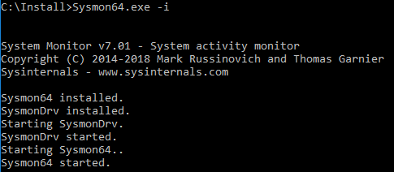
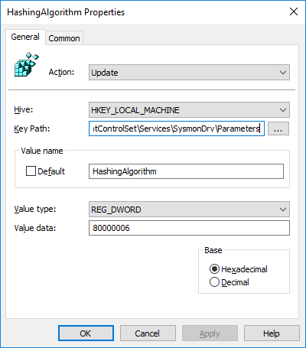
Sysmon Install
Basic install is as simple as running Sysmon from the command line with the –i install switch
Tools like SCCM allow for managed deployments and upgrades of the binaries
Group Policy Preferences can be used to manage settings/reg keys/files as well

Slide 49
Sysmon Install Information
Binaries are stored in %systemroot% (by default)
Logs are saved in Applications and Services Logs
Microsoft/Windows/Sysmon/Operational
Default log file size is 65,536KB – strongly recommend you increase the local log file size to capture the event window you are interested in
wevtutil sl <LogName> /ms:<MaxSizeInBytes>
E.g for 512MB log –
wevtutil sl Microsoft-Windows-Sysmon/Operational /ms:512000000

Slide 50
Sysmon Templates
Written in XML
Pick a good editor – some people like Notepad++ however I like Visual Studio Code (free and great)
Allows you to define filters (important) to reduce noise
Like clothing one size never fits all – select a good template as a baseline and then amend as necessary for your own environment

Slide 51
Sysmon – SwiftOnSecurity Template
Why this template?
Very well documented – XML file is full of comments and explanations
Extensive coverage
Good filtering
Use this as a starting point – optimise and expand for your own environment
As ever, test before deploying to production to fine tune coverage and ‘noise’ reduction
https://github.com/SwiftOnSecurity/sysmon-config

Slide 52
Sysmon Log Aggregation
Having logs on individual machines is useful – having them aggregated to allow business wide analysis is even better
If you have a full SIEM solution (Splunk, LogRhythm, SolarWinds, etc) you’re all set to ingest
Windows Event Forwarding is an option – no cost except of course the infrastructure to run the system and store logs
Handy MS guide in my blog post and appendices slides

Slide 53
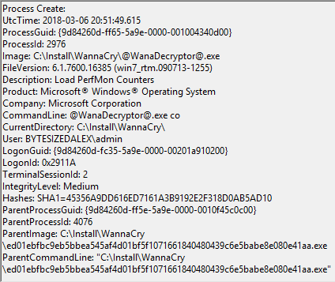
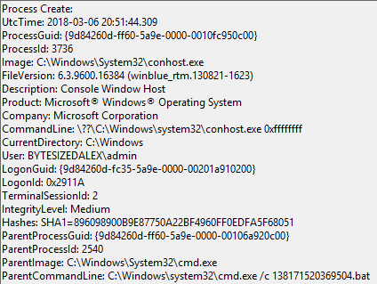
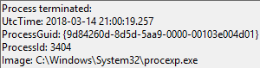
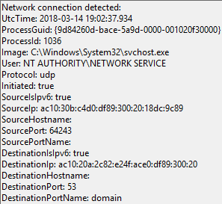
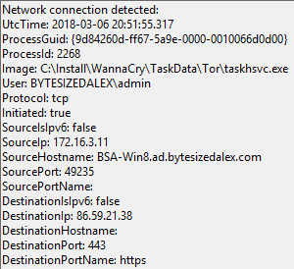
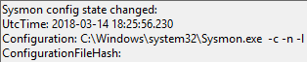
Sysmon Log Examples

Slide 54

Demo Time! ProcMon ProcExp Sysmon

Slide 55
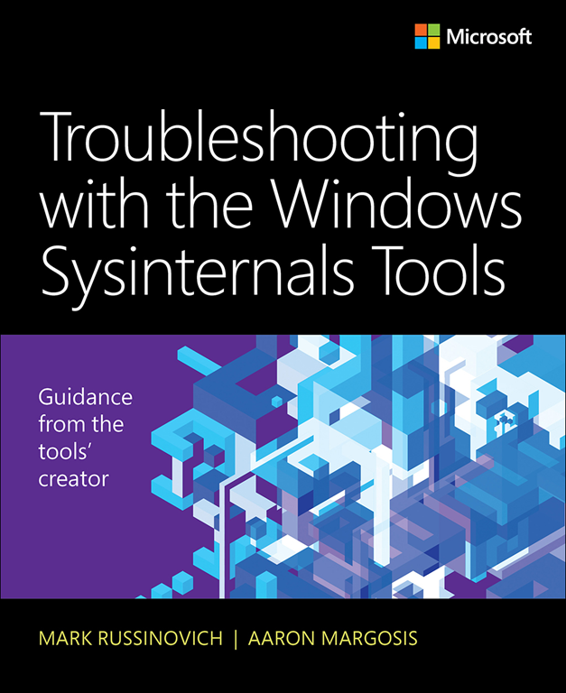
Further Reading
Microsoft Press - Troubleshooting with the Windows Sysinternals Tools
Make sure to get the second edition, October 2016

Slide 56
Remember…
The toolset is large, knowing which tool to use in each situation can be difficult
Keep up to date – enhancements and fixes are regularly released for key tools
Know what you’re doing before messing around with a new tool!
With great power comes great responsibility

Slide 57

Questions

Slide 58
Feedback
Feedback is truly valued; either directly or via the team at TechUG

Slide 59
Appendices

Slide 60
Sysinternals Links
Full suite
https://download.sysinternals.com/files/SysinternalsSuite.zip
Nano Server
https://download.sysinternals.com/files/SysinternalsSuite-Nano.zip
Forums
https://forum.sysinternals.com/

Slide 61
Sysinternals In Action
Recordings of Mark Russinovich using the Sysinternals suite to troubleshoot various problems as part of his ‘Case of the Unexplained’ series, plus MSDN ‘Channel9’ Sysinternals videos
https://docs.microsoft.com/en-us/sysinternals/learn/webcasts
https://blogs.technet.microsoft.com/markrussinovich/
https://channel9.msdn.com/Search?term=sysinternals#ch9Search&lang-en=en&pubDate=year

Slide 62

Symbol Paths
Many Sysinternals tools can be configured to download and use symbols to assist with troubleshooting/debugging
You will need an up to date version of Dbghelp.dll – easiest way is to install the Windows debugger (WinDBG)
https://docs.microsoft.com/en-us/windows-hardware/drivers/debugger/debugger-download-tools
To download public symbols from Microsoft and store them locally in a temp folder you can use the command syntax –
srv*c:\symbols*https://msdl.microsoft.com/download/symbols
Symbol cache can grow large –
https://www.bytesizedalex.com/compress-symbols-files-to-save-space/

Slide 63
Sysmon XML Editors
Visual Studio Code
https://code.visualstudio.com/
Notepad ++
https://notepad-plus-plus.org/
PowerShell ISE
Built-in to Windows
Start -> Run -> PowerShell_ISE

Slide 64
Sysmon Links
SwiftOnSecurity Sysmon XML Template
https://github.com/SwiftOnSecurity/sysmon-config
Mark Russinovich Sysmon Presentation
https://www.rsaconference.com/writable/presentations/file_upload/hta-w05-tracking_hackers_on_your_network_with_sysinternals_sysmon.pdf
Useful blog posts
https://blogs.technet.microsoft.com/motiba/2016/10/18/sysinternals-sysmon-unleashed/
https://blogs.technet.microsoft.com/motiba/2017/12/07/sysinternals-sysmon-suspicious-activity-guide/
https://cqureacademy.com/blog/server-monitoring/sysmon
https://cqureacademy.com/blog/server-monitoring/sysmon-configuration-file

Slide 65
Windows Event Forwarding Links
https://docs.microsoft.com/en-gb/windows/security/threat-protection/use-windows-event-forwarding-to-assist-in-intrusion-detection
https://social.technet.microsoft.com/wiki/contents/articles/33895.windows-event-forwarding.aspx
https://blogs.technet.microsoft.com/jepayne/2015/11/23/monitoring-what-matters-windows-event-forwarding-for-everyone-even-if-you-already-have-a-siem/
https://channel9.msdn.com/Events/Ignite/Australia-2015/INF327

Slide 66
WEF Guidance
Side-tracking from Sysinternals but handy…
Remember the 10 x 10 rule –
No more than 10,000 concurrently active WEF Clients per WEC server and no more than 10,000 events/second average event volume
Events/second range | Data store
0 - 5,000 | SQL or Security Event Manager (SEM)
5,000 - 50,000 | Security Event Manager (SEM)
50,000+ | Hadoop/HDInsight/Data Lake

